Slide 1
Software Construction
Evolution processes and activities

Slide 2
Introduction
In today’s class, we’re going to talk about how to implement a method, once you already have a specification. We’ll focus on one particular technique, recursion. Recursion is not appropriate for every problem, but it’s an important tool in your software development toolbox, and one that many people scratch their heads over. We want you to be comfortable and competent with recursion, because you will encounter it over and over.

Slide 3
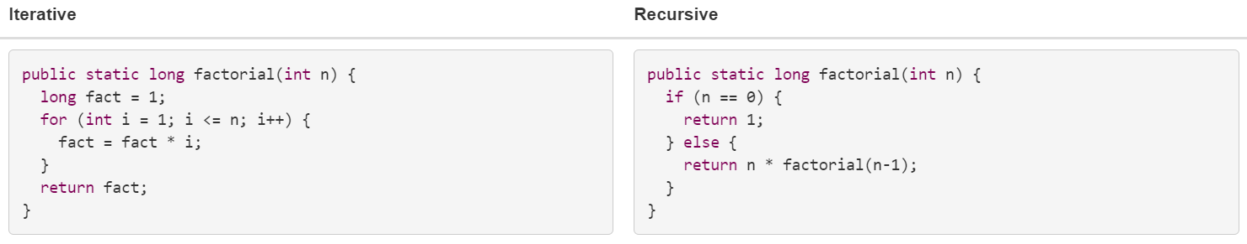
Recursion
Recursion is not completely new to you, and you have seen and written recursive functions like factorial and fibonacci before. Today’s class will delve more deeply into recursion than you may have gone before.
A recursive function is defined in terms of base cases and recursive steps.
In a base case, we compute the result immediately given the inputs to the function call.
In a recursive step, we compute the result with the help of one or more recursive calls to this same function, but with the inputs somehow reduced in size or complexity, closer to a base case.
Notes:
In the recursive implementation on the right, the base case is n = 0, where we compute and return the result immediately: 0! is defined to be 1. The recursive step is n > 0, where we compute the result with the help of a recursive call to obtain (n-1)!, then complete the computation by multiplying by n.

Slide 4
Cont...
Recursion consists of two parts: the base case and the recursive case. The base case defines when the recursion should stop, and the recursive case defines how the problem is broken down and the function is called again with a smaller or modified input.
Recursion is commonly used in algorithms for tasks like traversing trees and graphs, solving mathematical problems, and more.

Slide 5
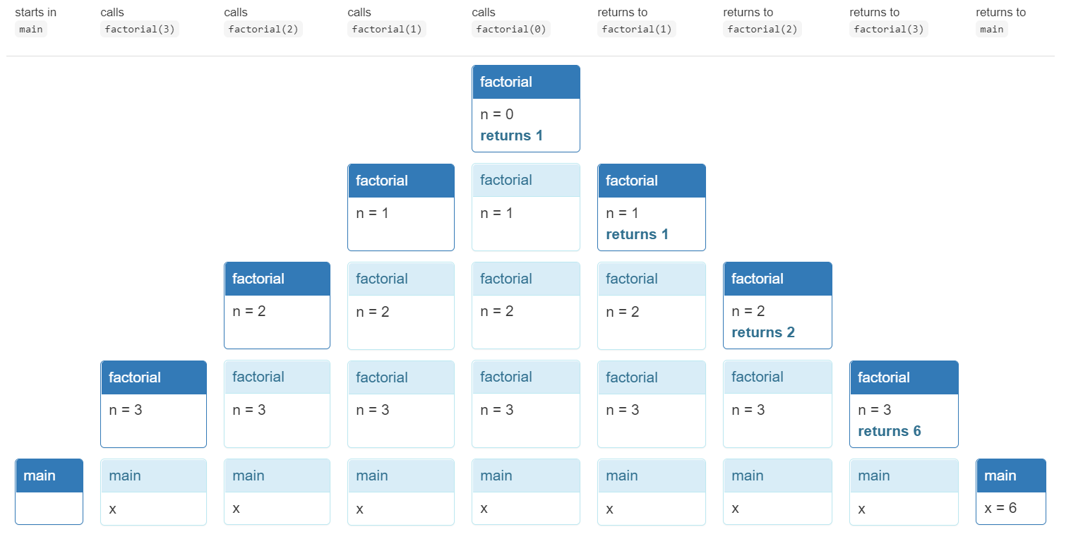
Cont.
Let’s run the recursive implementation of factorial in a main method:
public static void main(String[] args) {
long x = factorial(3);
}
At each step, with time moving left to right:
Notes:
In the diagram, we can see how the stack grows as main calls factorial and factorial then calls itself, until factorial(0) does not make a recursive call. Then the call stack unwinds, each call to factorial returning its answer to the caller, until factorial(3) returns to main.

Slide 6
Recursive Problems vs. Recursive Data (Fabonacci vs Binary Tree)
Factorial is easy to define in terms of smaller subproblems. Having a recursive problem like this is one cue that you should pull a recursive solution out of your toolbox.
Another cue is when the data you are operating on is inherently recursive in structure. Let’s look at the recursive data found in every laptop computer: its filesystem. A filesystem consists of named files. Some files are folders, which can contain other files. So, a filesystem is recursive: folders contain other folders which contain other folders, until finally at the bottom of the recursion are plain (non-folder) files.
For recursive data, it’s natural to write recursive implementations:
public static String fullPathname(File f) { if (f.getParentFile() == null) {
return f.getName(); }
else { // recursive step
return fullPathname(f.getParentFile()) + "/" + f.getName(); } }

Slide 7
When to Use Recursion Rather Than Iteration
We’ve seen two common reasons for using recursion:
The problem is naturally recursive (e.g. Fibonacci)
The data is naturally recursive (e.g. filesystem)
Another reason to use recursion is to take more advantage of immutability. In an ideal recursive implementation, all variables are final, all data is immutable, and the recursive methods are all pure functions in the sense that they do not mutate anything. The behavior of a method can be understood simply as a relationship between its parameters and its return value, with no side effects on any other part of the program. This kind of paradigm is called functional programming, and it is far easier to reason about than imperative programming with loops and variables.
In iterative implementations, by contrast, you inevitably have non-final variables or mutable objects that are modified during the course of the iteration. Reasoning about the program then requires thinking about snapshots of the program state at various points in time, rather than thinking about pure input/output behavior.
One downside of recursion is that it may take more space than an iterative solution. Building up a stack of recursive calls consumes memory temporarily, and the stack is limited in size, which may become a limit on the size of the problem that your recursive implementation can solve.

Slide 8
Common Mistakes in Recursive Implementations
Here are two common ways that a recursive implementation can go wrong:
The base case is missing entirely, or the problem needs more than one base case but not all the base cases are covered.
The recursive step doesn’t reduce to a smaller subproblem, so the recursion doesn’t converge.
Look for these when you’re debugging.
On the bright side, what would be an infinite loop in an iterative implementation usually becomes a StackOverflowError in a recursive implementation. A buggy recursive program fails faster.

Slide 9
Real-World Scenario: Navigating a Maze
To describe recursion with a real-world scenario, let's consider the example of exploring a labyrinth or maze.
Imagine you are inside a complex maze, and your goal is to find the exit. Navigating a maze can be compared to solving a problem using recursion.
Base Case: You are inside the maze, and there are specific conditions that indicate when you have reached a solution or an endpoint. In this case, the base case is reaching the exit.
Recursive Case: To navigate the maze, you examine your immediate surroundings. You identify possible paths or corridors to explore further. Each time you enter a new corridor, you find yourself in a situation similar to your starting point—inside a maze.
Recursion: Instead of solving the entire maze in one go, you use a recursive approach. You treat each corridor as a smaller sub-maze. You explore one corridor, and if you encounter a dead-end or the exit, you've solved that sub-maze. If you encounter another intersection, you apply the same process, treating it as a new, smaller maze to solve.

Slide 10
Cont…
Recursive Case: To navigate the maze, you examine your immediate surroundings. You identify possible paths or corridors to explore further. Each time you enter a new corridor, you find yourself in a situation similar to your starting point—inside a maze.
Recursion: Instead of solving the entire maze in one go, you use a recursive approach. You treat each corridor as a smaller sub-maze. You explore one corridor, and if you encounter a dead-end or the exit, you've solved that sub-maze. If you encounter another intersection, you apply the same process, treating it as a new, smaller maze to solve.

Slide 11
Other Examples
Tracing a Family Tree
Exploring a Book's Table of Contents
Solving a Jigsaw Puzzle
News Feed Algorithm (Iterative Process Flow)
Hashtag Search and Trending Topics (Parallel Process Flow)
User Profile and Privacy Settings (Defensive Programming)

Slide 12
Summary
We saw these ideas:
recursive problems and recursive data
comparing alternative decompositions of a recursive problem
using helper methods to strengthen a recursive step
recursion vs. iteration
The topics of today’s reading connect to our three key properties of good software as follows:
Safe from bugs. Recursive code is simpler and often uses immutable variables and immutable objects.
Easy to understand. Recursive implementations for naturally recursive problems and recursive data are often shorter and easier to understand than iterative solutions.
Ready for change. Recursive code is also naturally reentrant, which makes it safer from bugs and ready to use in more situations.

